Slide 1

Python Setup Guide
For TET4185 Power Markets
Spring 2022
By: Kasper Thorvaldsen

Slide 2
Installation guide Overview
Disclaimer: This overview is based on the authors preferred setup. There exists other setups and you’re free to choose your own way of doing it.
This setup will give a good overview and layout on how to code in python, at least this is my personal opinion
This guide focuses on Anaconda as the distributor of Python, but Visual studio codes is also an option:
https://code.visualstudio.com/docs/python/python-tutorial
Guide for Anaconda:
https://docs.anaconda.com/free/anaconda/install/windows/

Slide 3
Python via Anaconda
Anaconda:
“Anaconda is a free and open-source distribution of the Python and R programming languages for scientific computing (data science, machine learning applications, large-scale data processing, predictive analytics, etc.), that aims to simplify package management and deployment.” Wikipedia
Many packages included, and easy access to install further packages.
Can run python through «Spyder»:
Shows command window, console window, variable explorer and more
Pretty much same layout as MATLAB (own option actually to have it equal to MATLAB layout)

Slide 4
Download Python through ANACONDA
Go to this website: https://www.anaconda.com/download/
Choose the one appropriate for your OS, and download the latest version (as of 16.01.2019: Version 3.7)
Note: The version of Python is important regarding packages you install, such as Pyomo (more on that later). If choosing for instance Python 3.7, Pyomo version 5.6.6 is a good option, but newer versions will have compatibility issues.
I would recommend to choose either 3.8 or 3.9, those should be compatible with newest Pyomo-version (as of 02.02.2022, Pyomo V6.2)
Ignore the «Cheat sheet» popup
Note: It is recommended to download the Python 3 version, and not Python 2. There are differences between each version, and there is no guarantee that code will work between them. Python 3 is considered the most recent addition and the one you can expect the code I give you to work in

Slide 5
Install Anaconda
Run «Anaconda3-….»
Accept the license agreement (after reading it of course ;) )
Note: People have experienced a stop in installation if it is not run as administrator.
Choose a destionation folder
Advanced options:
Do not mark «Add anaconda to my PATH». This is an advanced method, and will make it so that your cmd window has access to Anaconda, which is not needed.
Mark «Register Anaconda as my default…»
Continue, and install Anaconda

Slide 6
Access Python -> Command window
Since you did not mark «add to PATH», opening a normal command window will not allow you to access Python
Instead, search for «Anaconda prompt» in your Start-menu, and open.
Write «python», and python will boot up
You can now code in python

Slide 7
Access Python -> Spyder
Instead of coding directly in command window, one can use the «Spyder» software (IDE)
Open «Anaconda Navigator» and choose «Spyder» (or just search for Spyder in your Start-menu)
You have now access to Spyder, where you can create scripts, run them, or write directly in command window (console window)

Slide 8
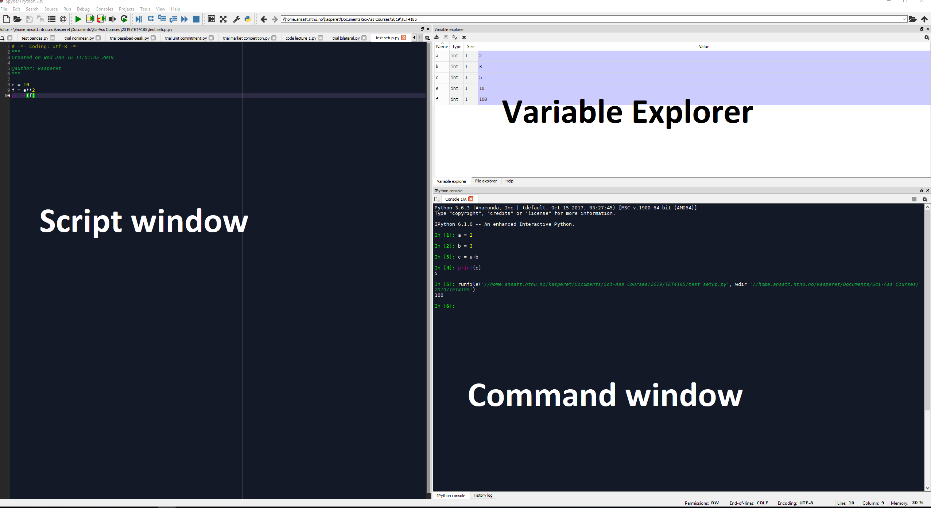
Spyder Layout (note that I use a dark background, can easily be adjusted)

Slide 9
Installing packages
Anaconda has a lot of starting packages included
Numpy
Matplotlib
etc
Although, sometimes we need some specific packages installed or their updated versions
We must do this manually, and there exists multiple packages depending on your situation
Google for solutions («Package for creating arrays»), there are many that knows what package to find

Slide 10
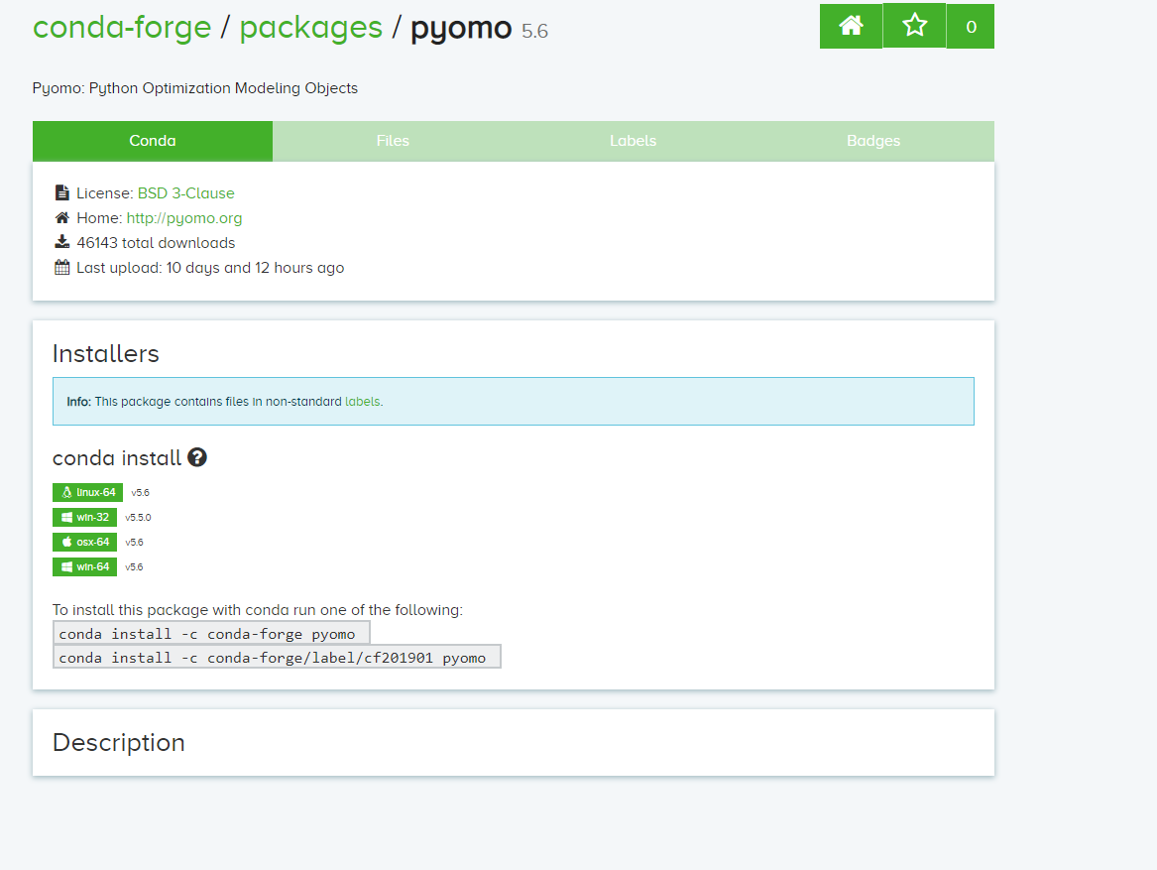
Finding package -> Pyomo
If we want to install/upgrade the package «Pyomo»
Search for «Anaconda Pyomo»
Find this website: https://anaconda.org/conda-forge/pyomo
We get information that we need to run some lines:
conda install -c conda-forge pyomo
Open «Anaconda prompt» (as admin)
Note: Some packages require a
specific version of Python to work

Slide 11
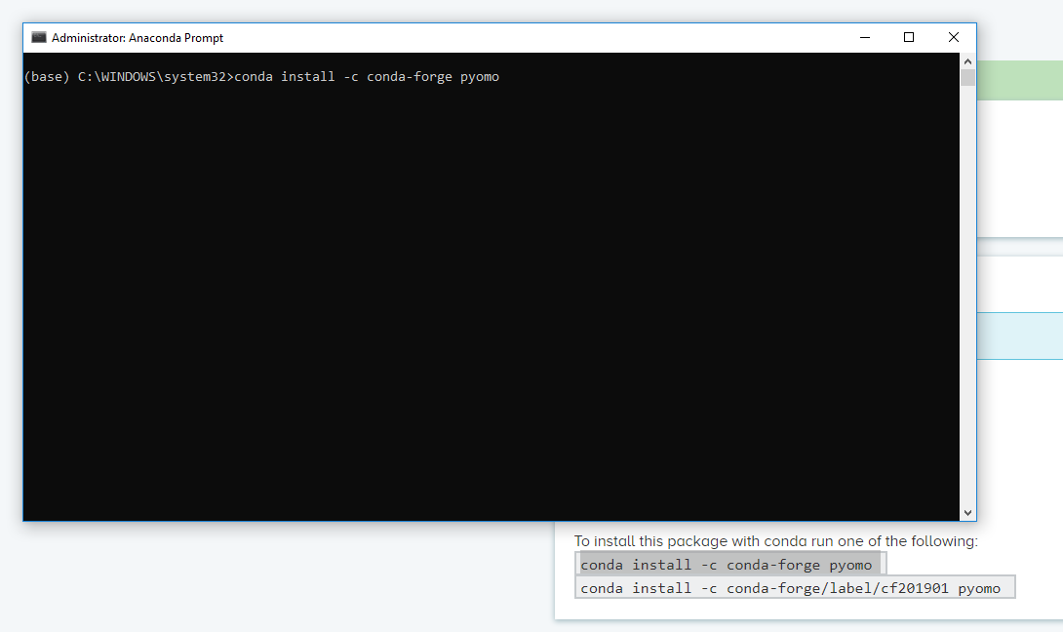
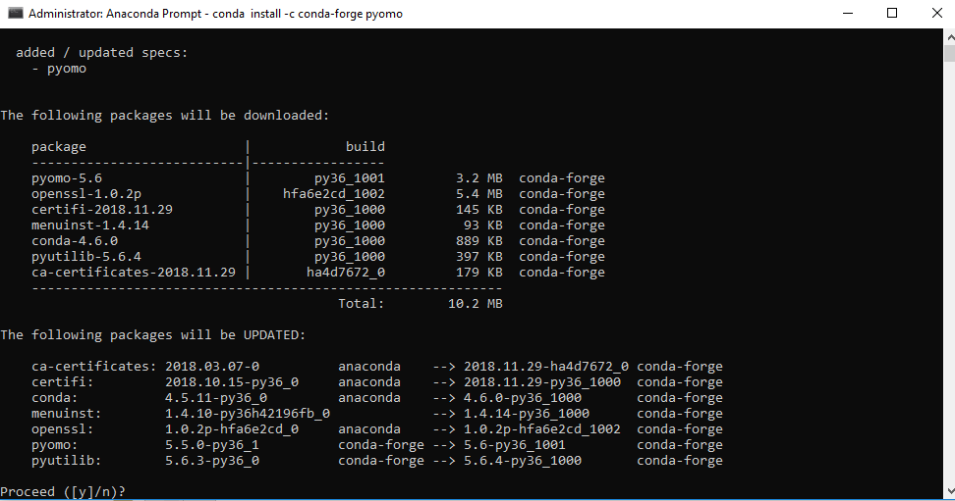
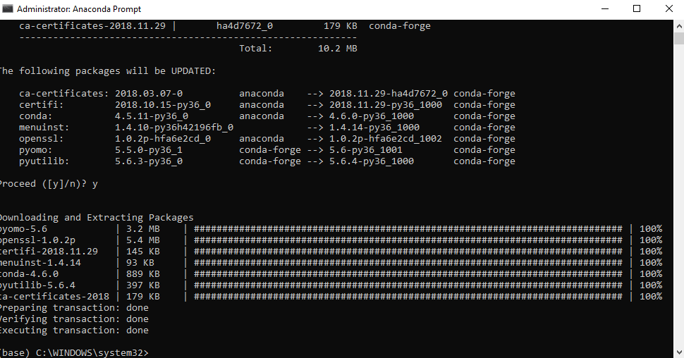
Installing package -> Pyomo
In Anaconda prompt, run the line you found
You will get info that some packages will be downloaded, upgraded and etc
Accept by writing «y»
After a while, the download is complete
Success, you have now downloaded a package, this is automatically included when you re-open Spyder/python
https://docs.anaconda.com/free/anaconda/packages/install-packages/

Slide 12
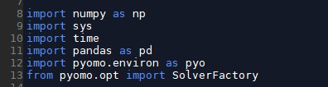
Tip when getting code to run
Check what packages are imported at the beginning
If unsure, proceed to download each package to ensure you have them
This is usually only necessary when you just started programming in Python
I will create a list of packages needed when given a code

Slide 13
Ta daa! Now you’re ready to code like a champion ☺

